Slide 1
Auto Insurance Management System
Md. Shakib Shah
Roll : 1909036
Department of Electronics and Communication Engineering (KUET)

Slide 2
Introduction :
A database is an organized collection of structured information, or data, typically stored electronically in a computer system. A database is usually controlled by a database management system (DBMS).
Auto insurance is a contract between vehicle's owner and the insurance company that protects him against financial loss in the event of an accident or theft. In exchange for his paying a premium, the insurance company agrees to pay him losses as outlined in his policy.
The objective of this Database Management System (DBMS) project is to design and develop a comprehensive Auto Insurance System that will improve the insurance data management process

Slide 3
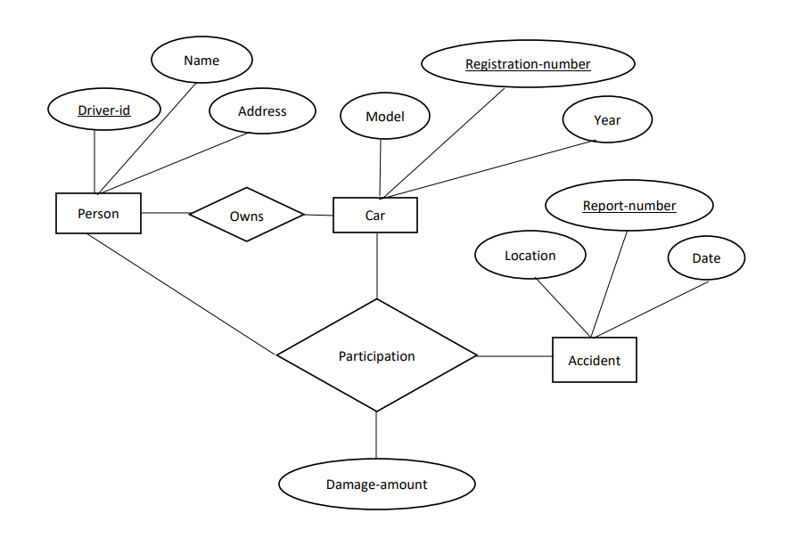
The ER Diagram:

Slide 4
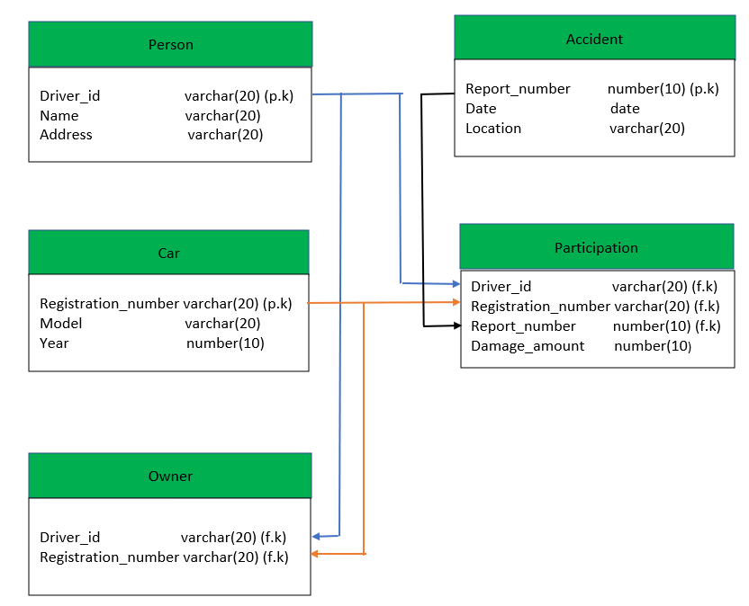
Schema diagram

Slide 5
Relations
PERSON
CAR
DRIVER_ID | NAME | ADDRESS
1 | Babur | Dhaka
2 | Humayun | Dhaka
3 | Akbar | Rajshahi
REG_NO | MODEL | YEAR
ka22 | hundai | 2010
ka23 | maruti | 2011
ka24 | zen | 2011

Slide 6
Relations
OWNER
ACCIDENT
DRIVER_ID | REG_NO
1 | ka22
2 | ka23
3 | ka24
REPORT_NO | REG_DATE | LOCATION
1 | 01-JAN-20 | Dhaka
2 | 03-OCT-20 | Sylhet

Slide 7
Relations
PARTICIPATION
DRIVER_ID | REG_NO | REPORT_NO | DAMAGE_AMOUNT
1 | ka22 | 11 | 5000
2 | ka23 | 12 | 15000

